Slide 1
NDOT Transportation Emissions Reduction Program
May 7, 2024
Notes:
Good Afternoon
My-linh has touched on the internal reduction efforts and I am going to address external efforts

Slide 2
Talking Points
‌Background
Methodology and Analysis
Key Themes
Strategies/Project Examples
Performance Measures
Public Involvement
Next Steps
Notes:
In this presentation I will touch on 7 points of topic
Back ground
Methodology and Analysis
Key Themes
Strategies and Project Examples
Performance Measures
Public Involvement
And our Next Steps

Slide 3
1
Background

Slide 4
Background
November 2021: President signed the Infrastructure Investment and Jobs Act (IIJA)
  Public Law 117-58, also known as the “Bipartisan Infrastructure Law” (BIL)
  BIL authorizes a new Carbon Reduction Program (CRP) to reduce transportation emissions
  FHWA requires the development of a State Carbon Reduction Strategy for transportation by November 2023
    In consultation with MPOs
    Shall support efforts to reduce transportation emissions, and identify projects and strategies to reduce these emissions
  States and MPOs are encouraged to obligate CRP funding for projects that support implementation of the State’s Carbon Reduction Strategy.
Notes:
It all began with the Bipartisan Infrastructure Law or BIL
Signed by the President in November of 2021
All states were required to develop a State Transportation Carbon Reduction Strategy due to the FHWA in November 2023
The plan must include all Transportations Entities within the state
supporting the reduction of transportation emission
identify projects and strategies to reduce the emissions
Both States and MPO’s are encouraged to obligate CRP funding that support the reduction strategy

Slide 5
Purpose of the Transportation Emission Reduction Program
Review/evaluate best practices for transportation carbon reduction
Develop a Transportation Emissions Reduction Working Group
Determine the baseline for transportation emissions in Nevada
Review transportation strategies that could reduce transportation carbon emissions
  Strategies include policies, programs and/or projects
Determine program performance measures
  For informing transportation decisions at NDOT and providing guidance to local and regional agencies
Notes:
To build our state plan we
Reviewed and evaluated best practices for reduction
put together an emission reduction working group
determined the baseline emissions for the state
reviewed strategies for reduction
this included policies, programs and projects at all levels
determined and build performance measures that guided us with transportation decisions and allowed us to provide guidance to local and regional agencies

Slide 6
Purpose of the Transportation Emission Reduction Program
Identify roles/agencies with the ability to implement various strategies
Determine eligible formula and discretionary funding sources for strategies, programs, and projects identified
Provide guidance on incorporation with Congestion Mitigation and Air Quality (CMAQ) program in coordination with Metropolitan Planning Organizations (MPOs)
Develop State Carbon Reduction Strategy document
Notes:
The purpose for the program was to identify were each agency served with the ability to implement the strategies
It allowed us to identify eligible funding sources
Provided guidance with working with the Congestion Mitigation and Air Quality or CMAC with the MPOs
Which led to a federal approved state Carbon Reduction Strategy document

Slide 7
2
Methodology and Analysis

Slide 8



Methodology Overview
2
Strategies, Project Examples, and Performance Measures Refinement
Implementation and Funding
4
1
National and Statewide Strategies Evaluation
Building the NDOT Carbon Reduction Strategy
Moving Forward
3
5
Notes:
Step 1: Identified 45 national and statewide strategies already in place
Strategies were evaluated against the following evaluation criteria: GHG Emissions Reduction Potential, Climate Justice Considerations, Budgetary & Economic Implications, and Implementation Feasibility.
Step 2: The 45 strategies were refined into 30 strategies. In total, 8 Themes/buckets are defined. For each strategy, 2~3 Project examples are identified. Relevant performance measures are developed and aligned to the themes and buckets.
Step 3: We collect the Stakeholder feedback for the themes, strategies, project examples, and performance measures. Accordingly, revise themes, strategies, project examples, and performance measures.
Step 4: Identify the approach and timeline for Implementing the carbon reduction strategy. Highlight the funding mechanisms and potential sources for strategies implementation.
Step 5: Define the coordination efforts with stakeholders, agencies, and partners involved in the implementation process. Highlight innovative approaches and project call-outs that demonstrate future-oriented strategies

Slide 9
Building the Carbon Reduction Strategy
Identification of initial strategies
Evaluation of strategies
Determination of NDOT key themes and strategy grouping
Development of project examples
Prioritization of strategies and projects
Identification of performance measures and goals
Public involvement
Ongoing agency and stakeholder coordination
Notes:
Building the reduction strategy is an ongoing agency and stakeholder coordination.
We continue to bring in new strategies, evaluate using the same metrics, determine where they belong in our groupings or themes, develop project examples, prioritize and identify performance measures

Slide 10
3
Key Themes
Notes:
There are 7 key themes

Slide 11
Key NDOT Themes
Efficiency
Construction Management
Energy
Diversification
Multimodal
Mobility
Implement measures across the transportation sector to improve fuel efficiency and optimize energy usage.
Incorporate sustainable practices and strategies into the construction of transportation infrastructure.
Transition to a wider range of renewable and low-carbon energy sources to reduce reliance on fossil fuels.
Develop an integrated transportation system with a focus on low-carbon transportation modes.
Process
Enhancement
Partnership and Collaboration
Congestion Management
Improve business processes and procedures to enable the adoption of sustainable practices that minimize environmental impacts.
Foster alliances and collaborations among stakeholders to achieve carbon reduction goals.
Address traffic congestion and improve traffic flow to promote a more sustainable transportation system.
Notes:
Efficiency – Enhance fuel efficiency across the transportation sector
Construction Management – make transportation infrastructure more sustainable
Energy Diversification – Increase opportunity of low-carbon and renewable energy sources
Multimodal Mobility – Create an integrated systems with a focus on low emission transportation
Process Enhancement – Minimize environmental impacts by improving business process and procedures
Partnerships and Collaboration – Build alliances and collaboration among stakeholders
Congestion Management – Improve traffic flow to promote a more sustainable system

Slide 12
Federal Goals Versus NDOT Themes
Federal Goals | Reduce traffic congestion by facilitating the use of alternatives to single-occupant vehicle trips. | Facilitate approaches to the construction of transportation assets that result in lower transportation emissions as compared to existing approaches. | Facilitate the use of vehicles or modes of travel that result in lower transportation emissions per person-mile traveled as compared to existing vehicles and modes.
NDOT Themes | Process Enhancement
 | Partnership and Collaboration
 | Congestion Management | Construction Management | Efficiency
 |  | Energy Diversification | Multimodal Mobility
Notes:
Federal goals – Reduce single occupancy vehicles, Construct assets with lower emissions than existing approaches, encourage the use of vehicle or modes that results in lower transportation emissions per person per mile.
NDOTs Themes included all the federal goals through out the 7 focus themes

Slide 13
4
Strategies/Project Examples
Notes:
These next slides show how we combined a theme and identified the strategy and project examples

Slide 14
Strategies/Project Examples
Theme | Tier 1 Strategies | Tier 1 Project Examples
Efficiency | Reduce Emissions from trucks | Implement Truck Parking Information Management Systems. Address greenhouse gas emissions in State-level freight planning.
 | Adopt Low-Carbon Fuel Standards | Adopt a low-carbon fuel standard for transportation fuels.
Construction Management | Promote Green Construction Practices Implementation | Promote the use of low-carbon and sustainable materials, such as low-carbon-intense asphalt for roadway construction. Recycle and reuse materials as part of maintenance repair, replacement, and rehabilitation activities. Develop project specifications and requirements in the construction of transportation projects for the reduction of carbon.
Energy Diversification | Expand EV Charging Infrastructure | Install EV charging infrastructure at public parking lots and shopping centers
 | Establish Zero-Emission Truck Programs | Implement targeted pilot projects and financial incentives to accelerate the transition of medium- and heavy-duty vehicles to zero-emission vehicles
 | Promote Electric Buses Adoption | Pursue funding options through grants and other methods to subsidize alternative fuel transit buses
Multimodal Mobility | Reduce Transit-Oriented Emissions | Implement sustainable measures, such as waste management, electric toll collection, and solar energy generation systems at transit facilities. Improve transit services through increases in trip frequency, expanded service areas, and enhanced reliability.
 | Improve Accessibility of Low-Carbon Transportation Options | Create a well-connected network of pedestrian and bicycle infrastructure. Support shared micro mobility programs. Update the statewide bicycle plan.
Notes:
Because this is a lot of information, I am not going to read every line but I will give you a few examples
For instance:
Construction Management – The strategy – To promote Green Construction Practice’s
The Project Example – To recycle and reuse materials
Multimodal Mobility – The strategy – Improve accessibility of low carbon transportation options
The project – Create well connected network of ped and bike infrastructure.

Slide 15
Strategies/Project Examples
Theme | Tier 1 Strategies | Tier 1 Project Examples
Process Enhancement | Implement a Quantitative GHG Measure for the Project Prioritization Process | Include GHG reduction as a criterion for project prioritization. Establish targets for GHG reduction and track progress toward meeting these targets.
 | Include GHG Reduction as an Objective for TSMO Under the "Foster Sustainability" Strategic Goal | Include GHG reduction as an objective for the TSMO plan. Develop specific targets and measures for this target, monitor the progress, and adjust as needed.
Partnership and Collaboration | Promote Agency Partnership | Establish joint task forces or working groups to share knowledge and best practices in reducing transportation emissions. Become a Clean City through the Clean Cities Coalition.
 | Promote Resilience to Climate Change Impacts | Integrate climate change considerations into transportation planning and design processes. Conduct vulnerability assessments to identify transportation infrastructure at risk from climate change.
Congestion Management | Implement Congestion Mitigation Strategies | Prioritize projects that enhance real-time traveler information Implement adaptive traffic signal control technologies
 | Improve Roadway Operations and Maintenance | Implement adaptive traffic signal control technologies Plan maintenance activities to reduce delays or unnecessary travel.
 | Implement Trip Reduction and Transportation Demand Management Strategies` | Implement active parking management.
Notes:
The theme – Partnership and Collaboration – The strategy – Promote Agency Partnership
The Project Example – The Clean Cities Coalition

Slide 16
5
Performance Measures
Notes:
Making sure we can measure our performance to real results

Slide 17
Program Performance Measures
Percent adoption of low-carbon and renewable fuels
1
Efficiency
Percent reduction in the carbon intensity of transportation fuels
5
Process
Enhancement
Number of projects that are prioritized based on their greenhouse gas reduction potential
Percent reduction of GHG emissions from roadway construction
2
Construction Management
Number of successful joint initiatives/programs to reduce carbon emissions and number of government agencies, private industry partners, community groups, or other organizations actively engaged in the collaborative programs
Number projects implemented that included requirements/incentives for green construction methods
6
Partnership and Collaboration
Number of EVs and AFVs registered/sold within a specific timeframe ((including number of zero-emission trucks)
3
Percent of stakeholders satisfied with the partnerships
Energy
Diversification
Number of alternative fuel buses integrated into the public transit fleet
Vehicles miles traveled (VMT) reduction
7
Congestion Management
Travel Time Index and planning time index
Reduction in single-occupancy vehicle trips and increase in low-carbon transportation mode share
Improvement in air quality
4
Multimodal
Mobility
Walkability and bikeabiliy Index
Notes:
The performance measures for our 7 themes range from percentages to travel times
Each of the themes requires it own individual measurement tool
Most of the themes have two identified measures
Efficiency - % of adoption and reduction
Construction Management - % of reduction and # of projects that included reduction
Energy Diversification - # of alt fuel vehicles and public transit fleets
Multimodal Mobility – walk and bike ability and reduction of single occupancy vehicle.
and Partnerships and collaboration
Process enhancement was assigned with just one measure of identifying how many projects were prioritized based off GHG reduction
And Congestions management has three identifiers, VMT, Travel Time, and air quality

Slide 18
6
Public Involvement
Notes:
Public Involvement brought our attention to what the people of Nevada think is most important

Slide 19
Public Involvement Campaign
Online public involvement campaign through the NDOT website from October 27 to November 10, 2023
Campaign included a video to provide information on the CRS, and an online survey to gather insights
Online and social media ads used to encourage survey participation, along with emails to stakeholder groups throughout Nevada
Survey asked participants:
  To rank their level of support for proposed strategies and projects
  (strongly supportive, supportive, neither unsupportive nor supportive, unsupportive, strongly unsupportive)
  If they have any questions or comments on the strategies
  Requested optional information from respondents including name, email, zip code, and ethnicity/race
Notes:
NDOT provided an online campaign that ran for two weeks through emails to stakeholder groups, online newspapers statewide, and social media ads to encourage survey participation.
The campaign included a video that provided information on the Carbon Reduction Strategy and led each participant to a survey where we asked participants to rank their level of support on strategies. Each participant could leave comments and ask questions.
There was a request for zip code information to help identify what was importation for each county, knowing statewide all of our needs are different.

Slide 20
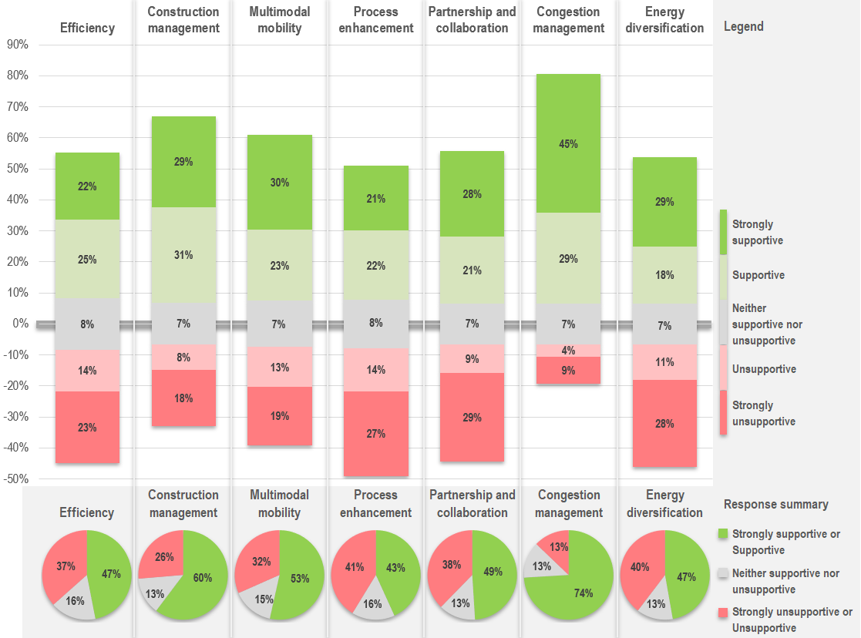
Public Involvement Campaign
What We Heard
479 responses
Responses by location
Category | Responses
Urban | 237
Non-urban | 41
Outside Nevada | 17
No Zip Code Provided | 184
Total | 479
Notes:
Involvement was strong
479 surveys were completed
From urban areas 237
Non – urban 41
People who did not provide a zip code - 184
Outside of Nevada 17
From the answers to the survey identification on hot topics was visually apparent
Congestion Management was the highest marker
Next Multimodal mobility
This graphs and pie charts have valuable information in them to help NDOT move forward on the issues Nevadans find important.

Slide 21
7
Next Steps
Notes:
So Now What? What happens next.

Slide 22
Status to date
Carbon Reduction Strategy
Submitted document to FHWA November 15, 2023
Approval from FHWA received February 20, 2024
Working on calculating emission reduction potential from proposed strategies (qualitative and quantitative)
Development of full Transportation Emissions Reduction Program
Notes:
As stated earlier in this presentation NDOT submitted the federal required document to the FHWA in November 2023
The plan was approved in February 2024
We are building qualitive and quantitative measures from our proposed strategies
And are working on the development of full transportation emission reduction program and sharing what we have learned with the Nevada MPO’s.

Slide 23
Next Steps
To successfully execute the initiatives within the CRS, NDOT will explore and leverage a range of funding, financing, and implementation options.
A mix of traditional and innovative funding mechanisms will provide NDOT the flexibility needed to support both near-term priorities and long-term investments.
NDOT will collaborate with partnering agencies to identify creative solutions that attract investment through shared benefits.
Notes:
The CRS will be implements using a range of funding and implementation options.
Traditional and innovative funding mechanisms will allow NDOT to meet short and long term goals
Through shared benefits, NDOT will collaborate with partnering agencies to develop creative solutions.

Slide 24

Q & A

